Slide 1

Smart home automation
Using Arduino

Slide 2

Presented by the team – chosen ones
Asra Shamshad – r20en175
5th Sem ece
Harshika M – r20en191
5th sem ece
Arun S Mali – r20em013
5th sem Eee
From,
Reva university.

Slide 3
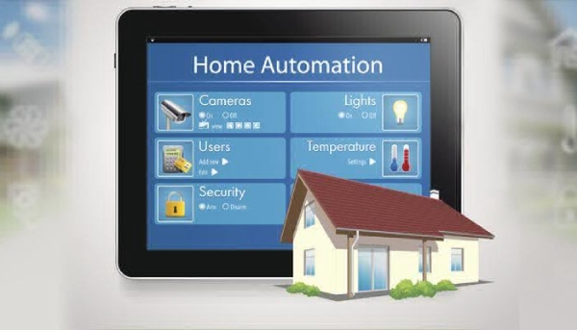
Agenda
Abstract and introduction
Components
Briefing about the components
Programming code
Tinker Cad Connection
Advantages and disadvantages
conclusion

Slide 4
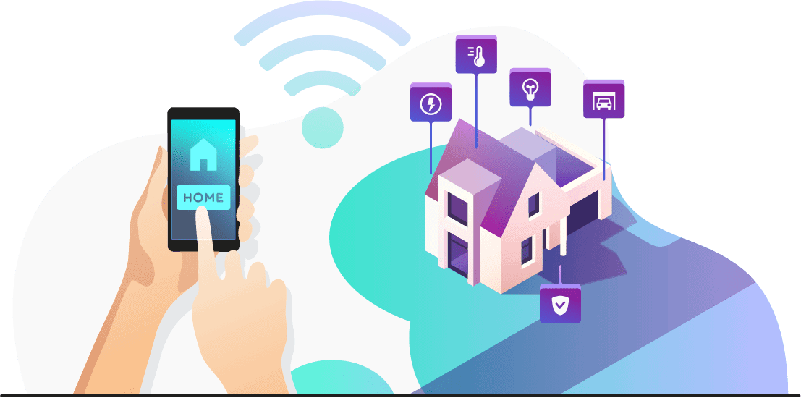
Abstract and introduction
Abstract:
The aim of this project is to develop a system that will provide remote control of home appliances and, also provide security against intrusion when the home host is not at home. This paper is mainly concerned with the automatic control of light or any other home appliances using internet. It is meant to save the electric power and human energy .Home automation systems have drawn considerable attentions of the researchers for more than a decade.
Introduction:
A smart home is a home-like environment that possesses ambient intelligence and automatic control, which allow it to respond to the behavior of residents and provide them with various facilities. Home automation may include centralized control of lighting, heating, ventilation and air conditioning appliances, and other systems, to provide improved convenience, comfort, energy efficiency and security

Slide 5

Components required
Arduino board
16*2 LCD display
SMOKE DETECTOR MQ6
PIR
LDR
ULTRASONIC sensor
Dc power source (Any 12v)
Relay Board of 2 channel

Slide 6
Problem Statement
Brief Solution
Nowadays humans are much dependent on the appliances in each of his daily activities. It is very hard for a specially disabled person to operate the devices on his own. There are also the elderly citizens and children who are dependent on others to operate the home devices. Sometimes it is dangerous and waste of the energy when the person has forgotten to switch off the appliances. There is also need to modernize the style of living.
We can design a system which contains required sensors such as temperature sensor , smoke detector , passive infrared sensor , ultrasonic sensor and many more , interfacing these sensors with Arduino. This smart home automation system will be very helpful for specially disabled people as it can ease their task in many ways . as the global warming is increasing this system is best as it saves energy . as it saves a lot of time and will be help in supervising the elderly persons and children which gives a peace of mind for the caretakers. This smart system can not only be implemented at home it can also be implemented in schools , college's , industries and in many sectors.

Slide 7
Advantages and disadvantages of using Arduino
Advantages:
Disadvantages:
Ready to use.
Effortless function.
Large community.
Structure.
Costs.

Slide 8
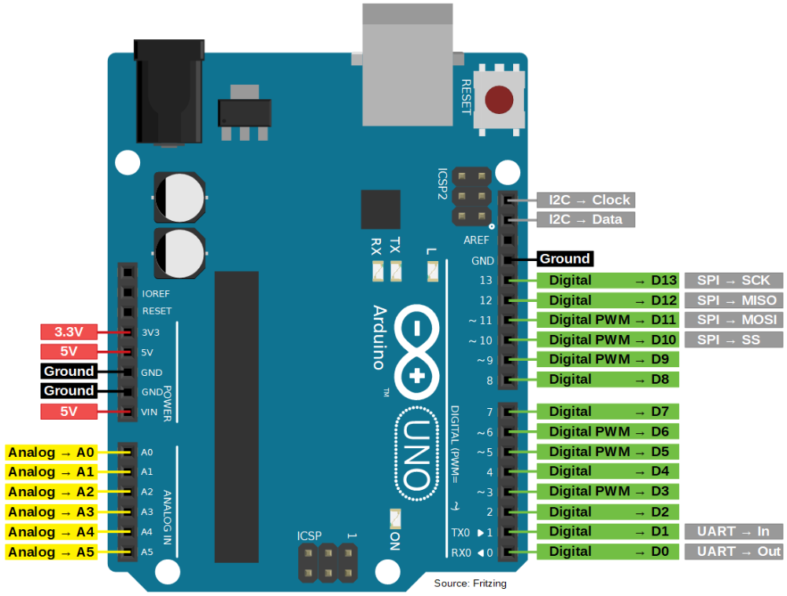
What is Arduino?
Arduino is an open-source prototyping platform based on easy-to-use hardware and software.
Arduino boards can read inputs (light on sensor, or twitter message) and turn it in to output (activating motor, turn LED, publishing something online).
You can tell the board what to do by sending set of instruction to the microcontroller on the board to do that use the Arduino programming language and Arduino software based on processing.

Slide 9
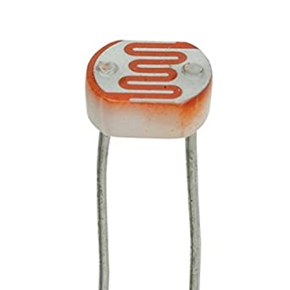
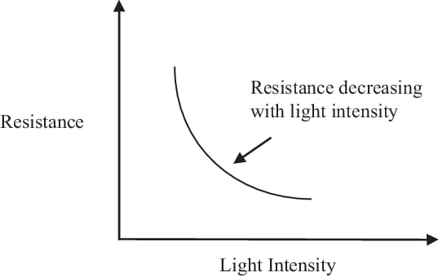
Ldr – light dependent resistor
A photoresistor (or light-dependent resistor, LDR, or photocell) is a light- controlled variable resistor.
The resistance of a photoresistor decreases with increasing incident light intensity; in other words, it exhibits photoconductivity.
A photoresistor can be applied in light-sensitive detector circuits, and light- and dark-activated switching circuits.

Slide 10
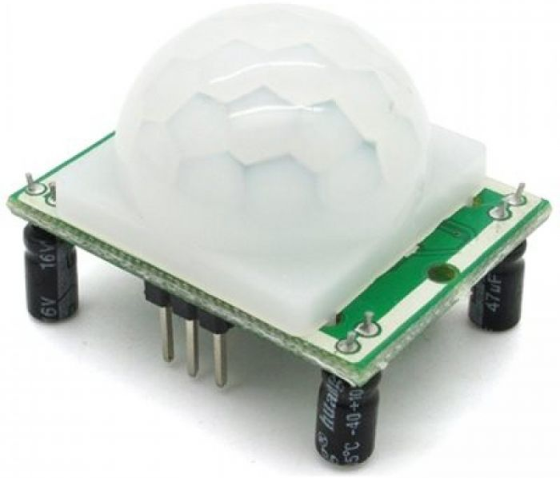
Pir - passive infrared
PIR sensors allow you to sense motion, almost always used to detect whether a human has moved in or out of the sensors range.
They are small, inexpensive, low-power, easy to use and don't wear out.
For that reason, they are commonly found in appliances and gadgets used in homes or businesses.

Slide 11
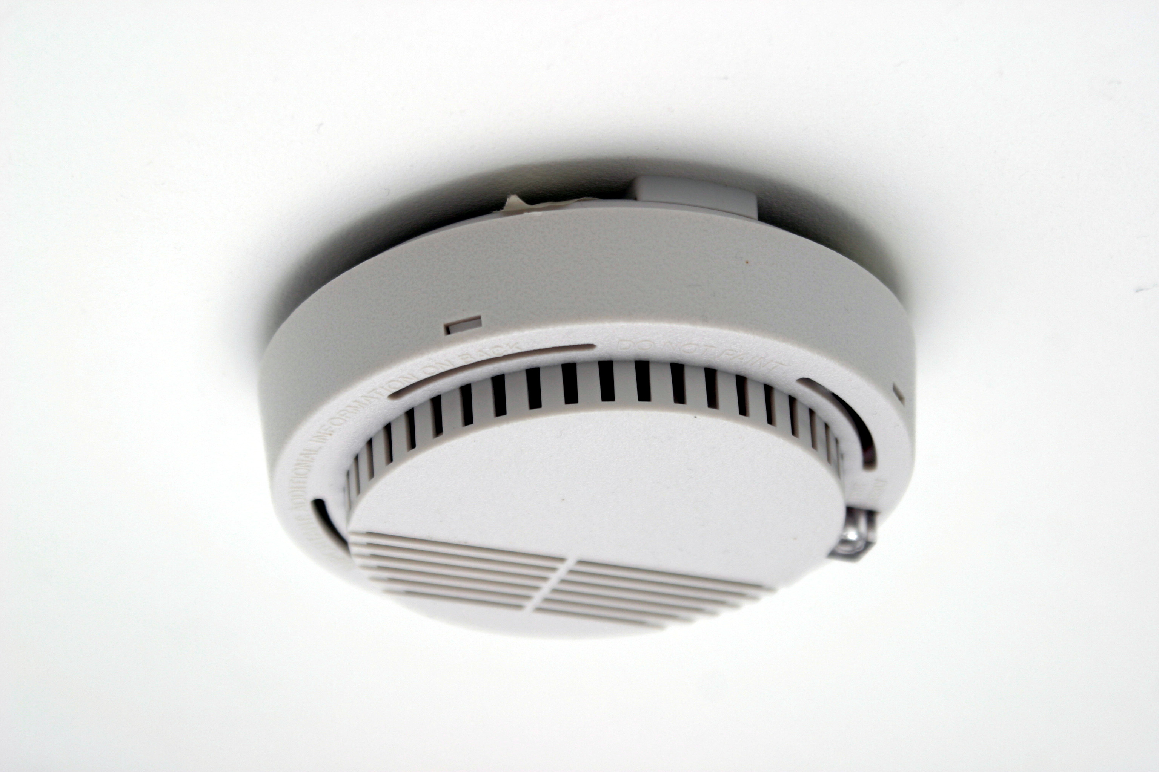
Smoke detector
This flammable gas and smoke sensor detects the concentrations of combustible gas in the air and outputs its reading as an analog voltage.
The sensor can measure concentrations of flammable gas of 300 to 10,000 ppm.
The sensor can operate at temperatures from -20 to 50°c and consumes less than 150 ma at 5 v.

Slide 12
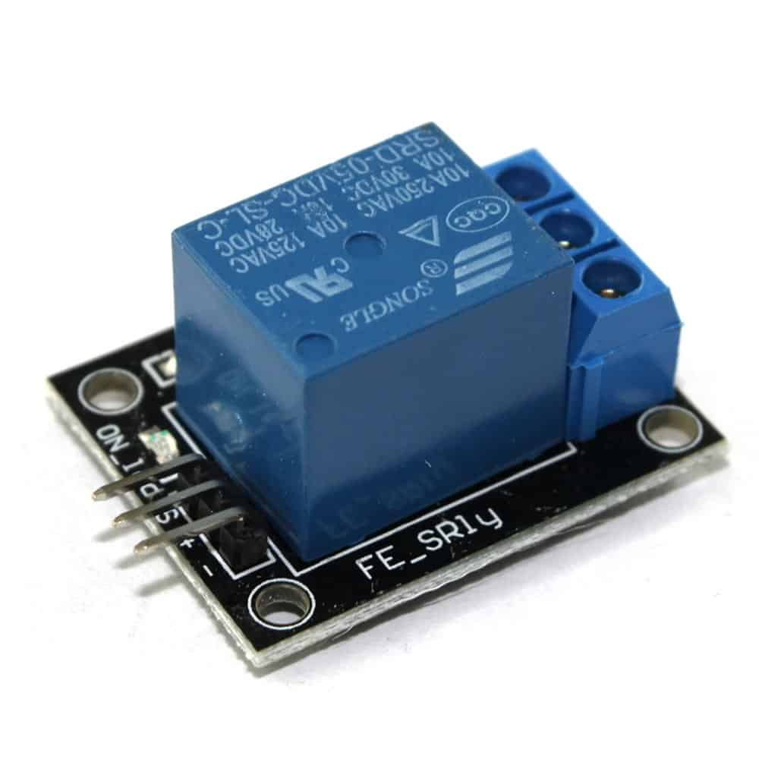
Relay sensor
It is used to close the reset switch on A node and to keep the node's power and ground isolated from the other nodes and the Arduino.

Slide 13
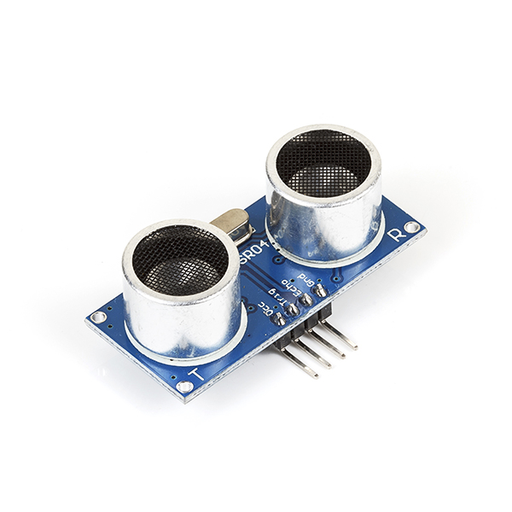
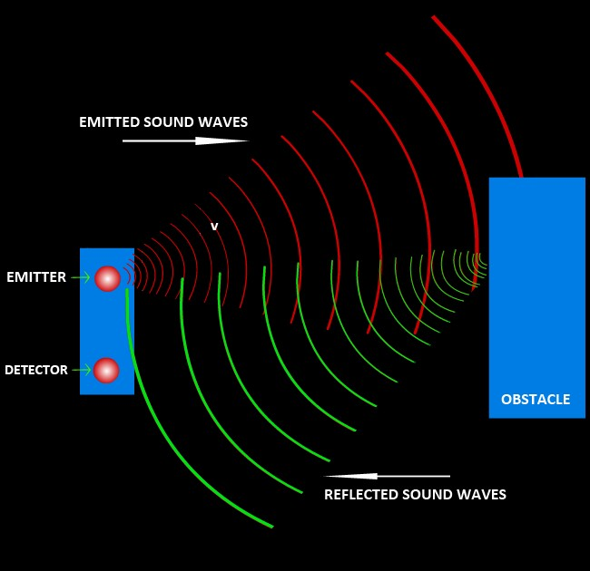
Ultrasonic sensor
An ultrasonic sensor is an electronic device that measures the distance of a target object by emitting ultrasonic sound waves and converts the reflected sound into an electrical signal. It has two components,
The transmitter (which emits the sound using piezoelectric crystals)
The receiver (which encounters the sound after it has travelled to and from the target).
An ultrasonic sensor emits sound waves toward an object and determines its distance by detecting reflected waves.

Slide 14
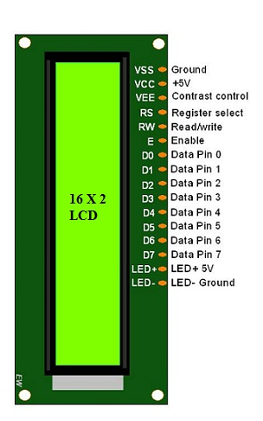
Lcd – Liquid crystal display
LCD is one kind of electronic display module.
These displays are mainly preferred for multi-segment light-emitting diodes and seven segments.
The main benefits of using this module are inexpensive; simply programmable, animations, and there are no limitations for displaying custom characters, special and even animations, etc.

Slide 15
Features of LCD 16x2
The operating voltage of this LCD is 4.7v-5.3v
It includes two rows where each row can produce 16-characters.
The utilization of current is 1ma with no backlight every character can be built with a 5×8 pixel box.
The alphanumeric lcds i.e. Alphabets & numbers can be displayed.
These are obtainable in blue & green backlight.
It displays a few custom generated characters

Slide 16
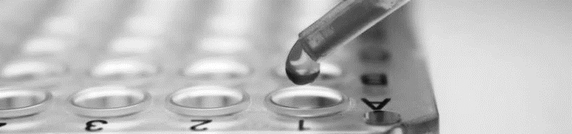
Programming code:
// include the library code:
#include <LiquidCrystal.h>
// initialize the library with the numbers of the interface pins LiquidCrystal lcd(12, 11, 5, 4, 3, 2);
//For ultrasound sensor
int distanceThreshold = 0;
int cm = 0;
int inches = 0;
//for Relay Control
int releNO = 13;
int inputPir = 8;
int val = 0;
int resuldoSensorLDR;
int sensorLDR = A0;
//For Gas sensor
int const PINO_SGAS = A1;

Slide 17
long readUltrasonicDistance(int triggerPin, int echoPin)
{
pinMode(triggerPin, OUTPUT); // Clear the trigger
digitalWrite(triggerPin, LOW);
delayMicroseconds(2);
// Sets the trigger pin to HIGH state for 10 microseconds
digitalWrite(triggerPin, HIGH);
delayMicroseconds(10);
digitalWrite(triggerPin, LOW);
pinMode(echoPin, INPUT);
// Reads the echo pin, and returns the sound wave travel time in microseconds
return pulseIn(echoPin, HIGH);
}
void setup() {
// set up the LCD's number of columns and rows:
lcd.begin(16, 2);
pinMode(releNO, OUTPUT);
pinMode(inputPir, INPUT);
pinMode(sensorLDR, INPUT);
Serial.begin(9600);
}

Slide 18
void loop() {
// set threshold distance to activate LEDs
distanceThreshold = 350;
// measure the ping time in cm
cm = 0.01723 * readUltrasonicDistance(7, 6);
// convert to inches by dividing by 2.54
inches = (cm / 2.54);
lcd.setCursor(0,0);
// Sets the location at which subsequent text written to the LCD will be displayed
lcd.print("D:"); // Prints string "Distance" on the LCD
lcd.print(cm); // Prints the distance value from the sensor lcd.print("cm");
delay(10);
val = digitalRead(inputPir);
resuldoSensorLDR = analogRead(sensorLDR); if(resuldoSensorLDR<600)
{
if(val == HIGH)
{
digitalWrite(releNO, HIGH);
lcd.setCursor(0,1);
lcd.print("L: On ");
delay(5000);
}

Slide 19
else{
digitalWrite(releNO, LOW);lcd.setCursor(0,1);
lcd.print("L: Off");
delay(300);
}}
else{ digitalWrite (releNO, LOW);
Serial.println(resuldoSensorLDR);
delay(500);
}
int color = analogRead(PINO_SGAS);
lcd.setCursor(8,0);
//lcd.print("");
if(color <= 85)
{ lcd.print("G:Low ");
}
else if(color <= 120){
lcd.print("G:Med ");
} else if(color <= 200){
lcd.print("G:High");
} else if(color <= 300){
lcd.print("G:Ext "); }
delay(250);}

Slide 20
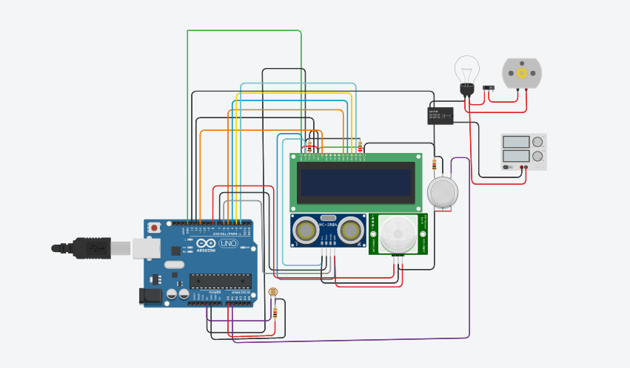
Working of the system
SIMULATION LINK:
https://www.tinkercad.com/things/l6TMcq6jR9G-fantabulous-lahdi-migelo/editel

Slide 21

advantages
Save energy with smart energy consumption.
Customize as per your convenience.
Ease of using smart home technology.
They are remote controllable.
Time saving.

Slide 22
disadvantages
Cost is high , only few can afford.
Dependency on internet.
Dependency on professionals.
In some cases, security issues

Slide 23

conclusion
We have designed a system that contains of many sensors using Arduino such as smock detector, photoresistor sensor and more sensors can be added accordingly. This control reinterpreted many features to the home make it the ideal home that most companies aspics to design, which is more secure and energy efficient to be the home of future. We proposed the use of home automation as an effective means to reduce consumption of energy and other resources.

Slide 24

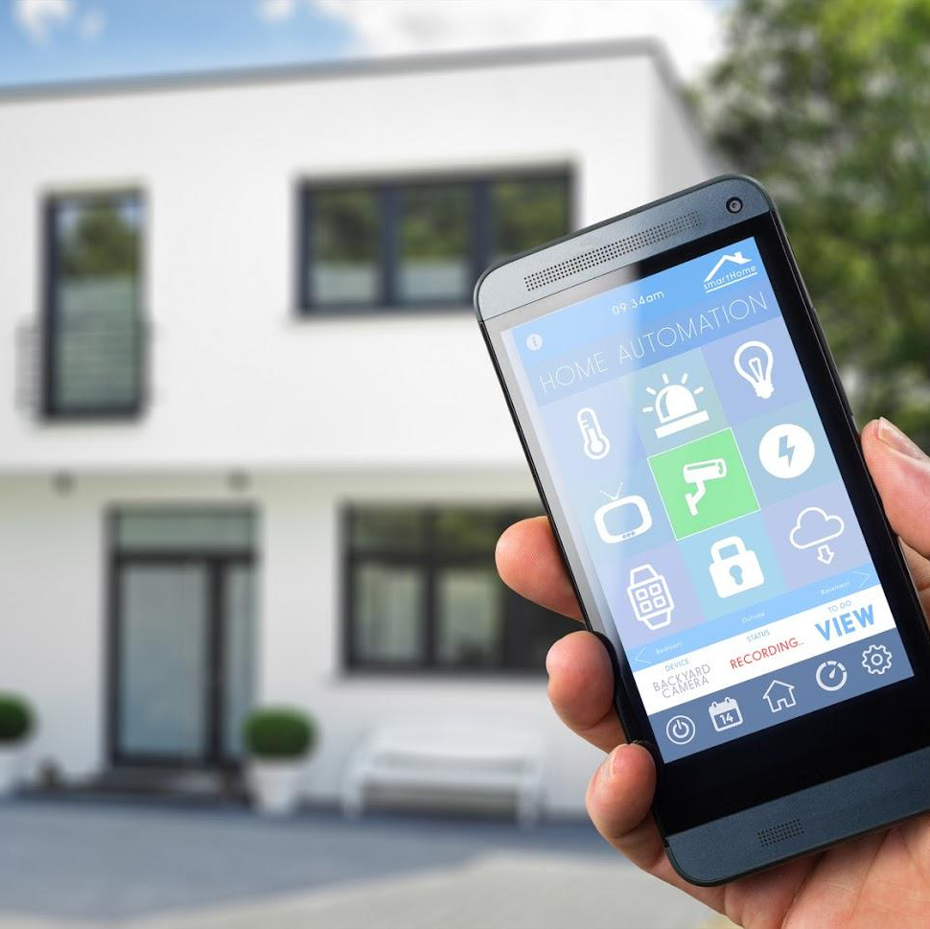
Thank you

